Slide 1
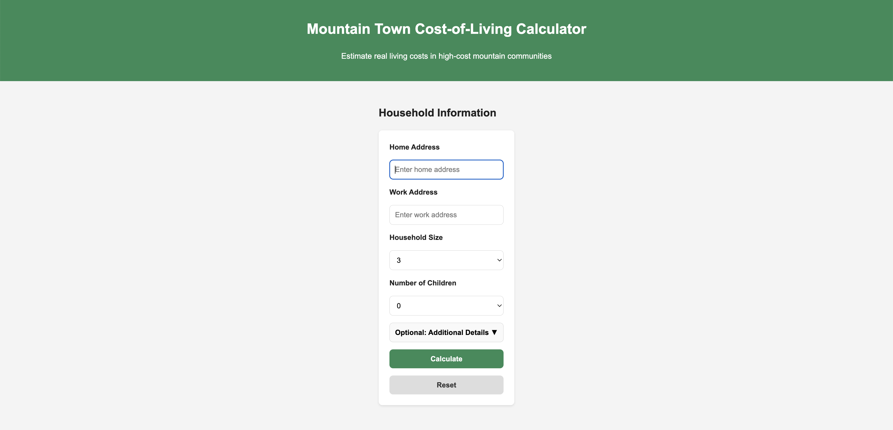
Landing Page
Clean, accessible interface built for residents, policymakers and grant writers
Demo version displays placeholder results
Built for desktop and mobile use

Slide 2
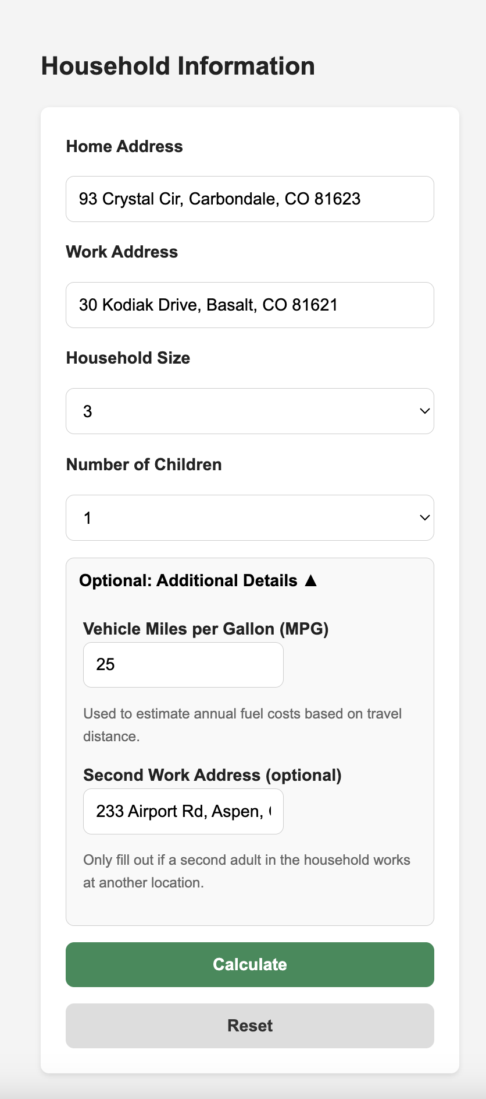
Household Input Form
Collects home and work addresses, household size, and dependents
Optional fields for MPG and second work address refine travel estimates
Built to capture commute impacts and household structure
Clean design with clear inputs and controls

Slide 3
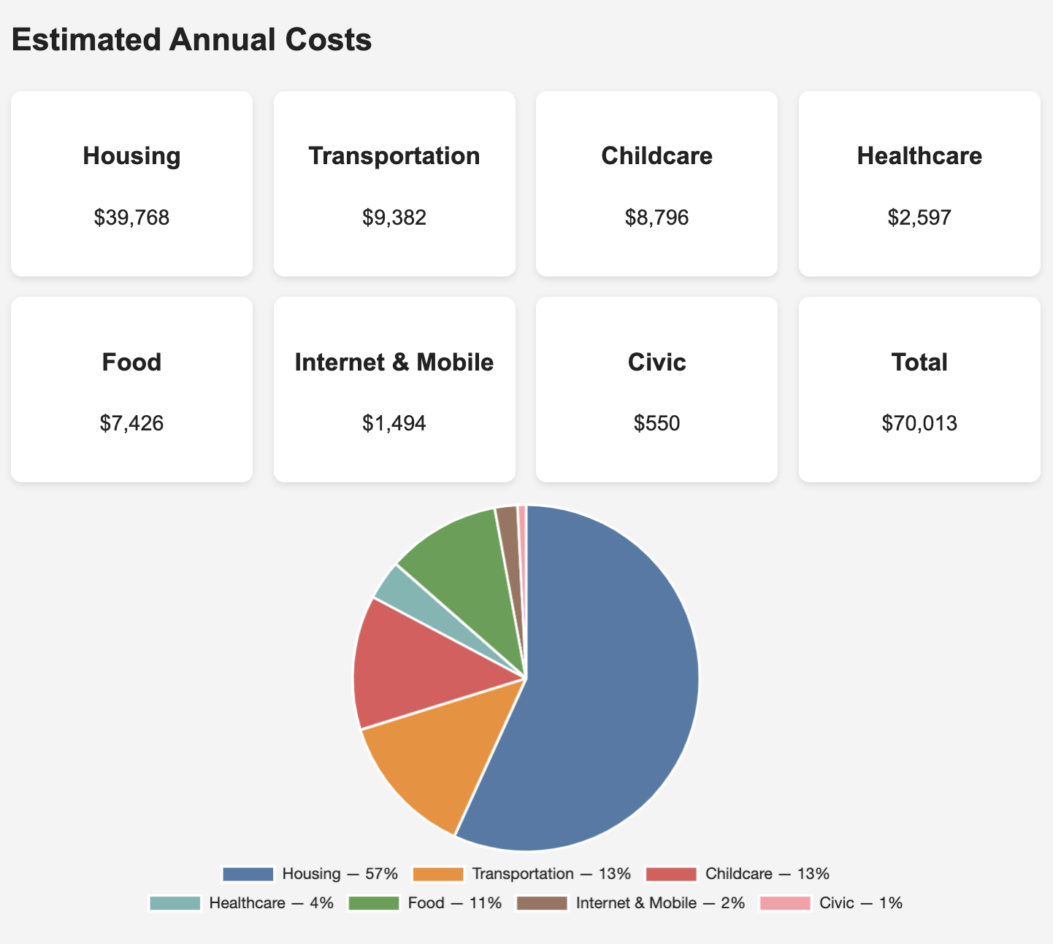
Results Cards and Cost Breakdown
Calculates annual costs across key categories: housing, transport, childcare, healthcare, food, internet and mobile, and civic fees
Dynamic cards update instantly after submission
Interactive pie chart displays each expense’s share of total costs
Responsive and visually intuitive layout

Slide 4
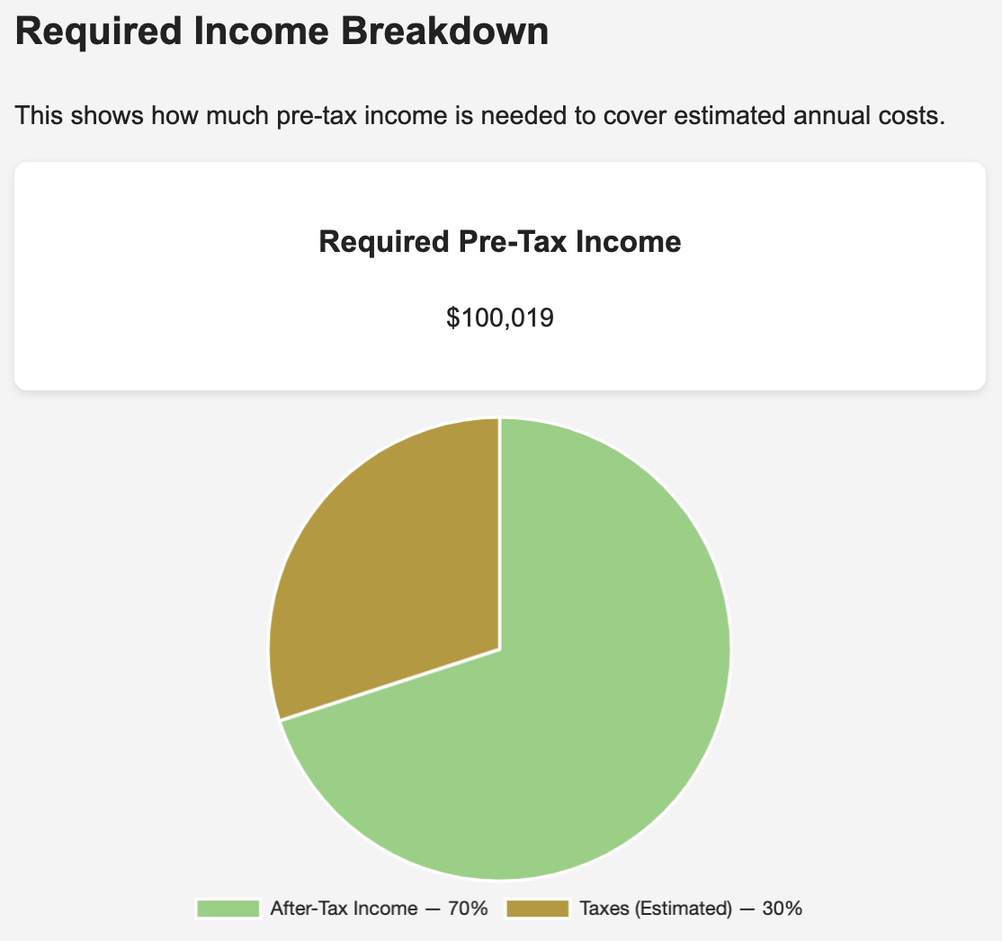
Required Income Breakdown
Converts total household costs into required pre-tax income
Highlights relationship between expenses, taxes, and take-home pay
Supports understanding of affordability by household type

Slide 5
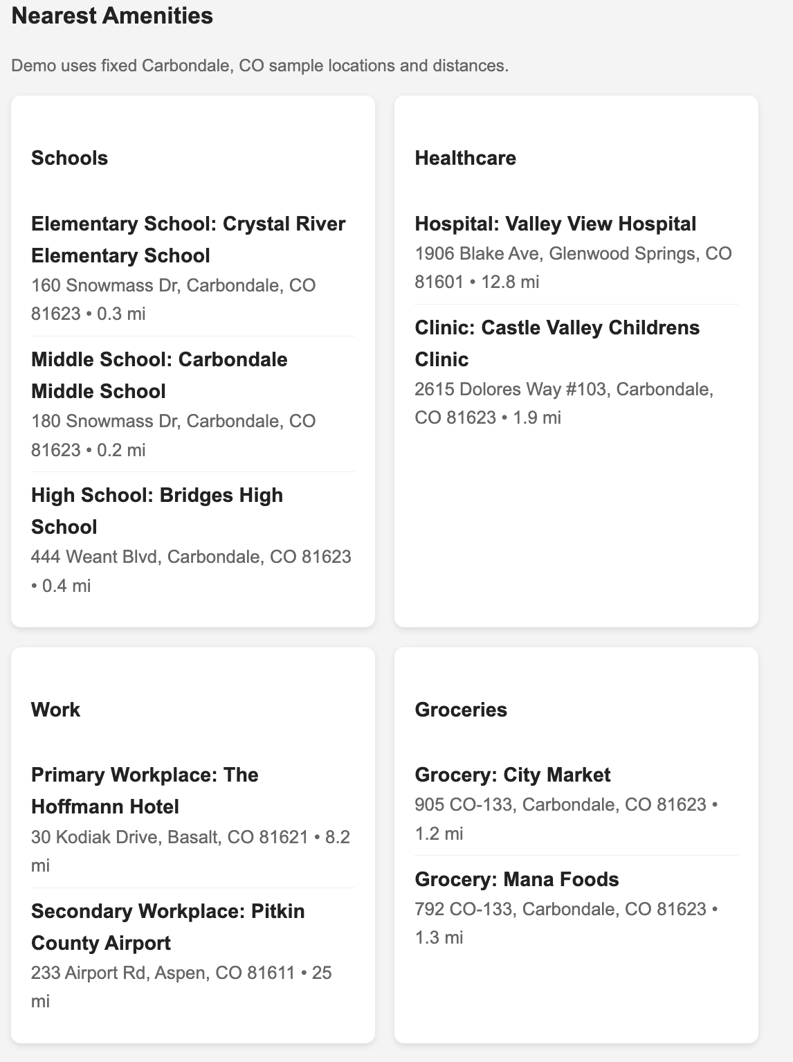
Amenities View
Maps proximity to essential services like schools, healthcare, groceries, and workplaces
Connects accessibility to overall cost of living
Demonstrates spatial awareness and local context of the tool

Slide 6
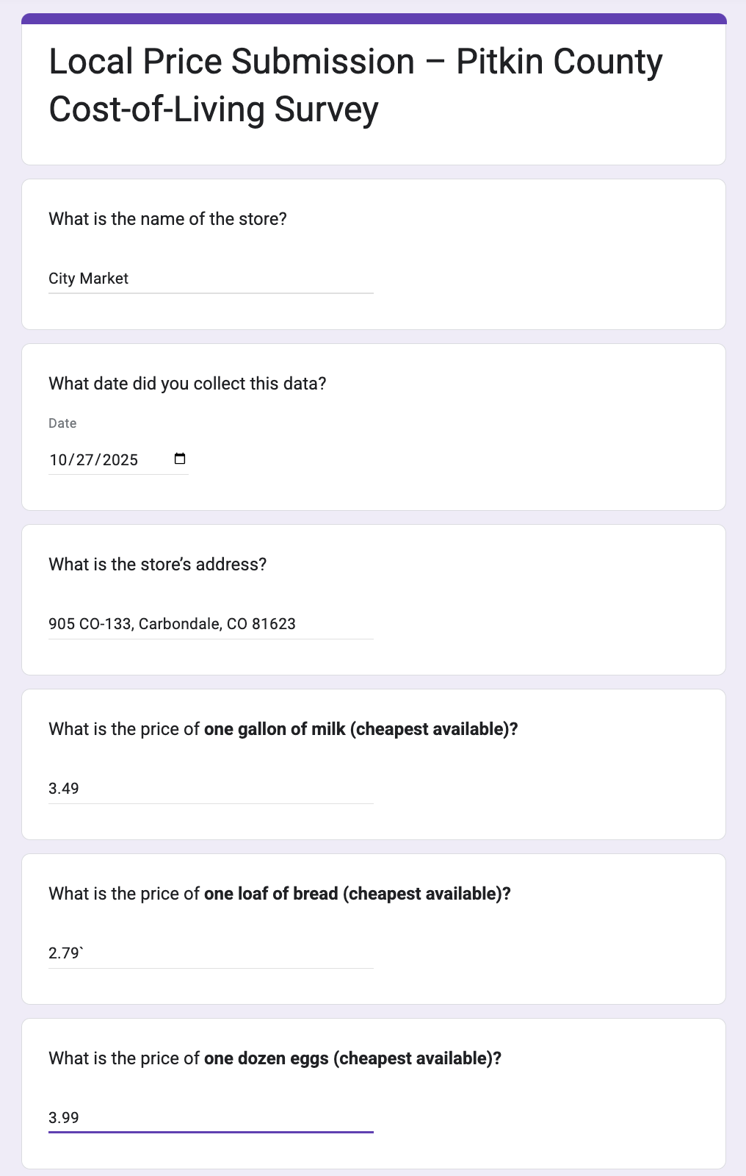
Hyper-Local Price Collection
Enables community partners or county staff to input local prices directly from stores
Uses a simple Form to collect data like store location, and common item costs
Creates a ground-truth dataset for groceries, fuel, and essential goods
Keeps the calculator accurate for each community rather than relying on national or county averages

Slide 7
What Sets Our Cost-of-Living Tool Apart
Uses hyper-local pricing inputs gathered directly from stores, gas stations and service providers—captures real conditions in high-cost mountain towns.
Enables community data collection workflows (e.g., store survey form) so the dataset reflects current, local realities rather than broad national averages.
Calculates cost based on household-specific inputs (commute distances, vehicle MPG, number of dependents) so outcomes match the lived experience of individual households.
Integrates spatial interaction concepts to model how access (or lack thereof) to services, amenities and housing affects cost of living in isolated or mountain-terrain communities.
Designed for actionable decision-making by local governments, employers and planners, supports wage benchmarking, affordability policies and targeted subsidy design at the town/regional level.
Transparent, downloadable methodology so users can trace how each cost component is derived.

